Slide 1

Keylogger Threat Analysis
Srinivas Devara - Y00855264
Hareesh Ginjupally - Y00856729
Bhanu Teja vejendla – Y00857603

Slide 2
Agenda
Introduction to Keyloggers
Problem Statement
Project Description
Methodology
Timeline and Phases
Keylogger Functionality Study
Detection and Countermeasure Assessment
Analysis and Reporting
Results
Conclusion
References

Slide 3
Introduction and Background
1. Definition & Evolution
- Keyloggers: Software/hardware tracking keystrokes.
- From simple keystroke recorders to advanced tools capturing screenshots, browser history, etc.
2. Types
- Hardware: Physical devices attached to computers.
- Software: Installed programs.
- Kernel-based: Embedded in the OS for in-depth monitoring.
3. Uses & Considerations
- Legitimate: Parental control, business security.
- Malicious: Data theft, privacy invasion.
- Legal/Ethical: Usage governed by laws and ethical norms.

Slide 4
Problem Statement
1. Evolving Sophistication
- Advanced capabilities of modern keyloggers, surpassing basic keystroke logging.
2. Security Implications
- Risks to individual privacy and organizational data security.
3. Urgent Needs
- Greater understanding of keylogger technologies.
- Enhanced detection and countermeasures.

Slide 5
Project Description
1. Goals and Objectives
- To analyze the functionality of various keyloggers.
- To test and evaluate detection methods and countermeasures.
2. Project Significance
- Enhances understanding of keylogger risks.
- Contributes to developing better security strategies.
3. Approach
- Combination of practical experimentation and theoretical analysis.
- Use of controlled environments for safe testing.

Slide 6
Methodology
1. Experimental Setup
- Use of virtual machines to create a controlled testing environment.
- Installation of various keyloggers for functional analysis.
2. Tools Employed
- Diverse range of keyloggers for comprehensive coverage.
- Antivirus and anti-keylogging software for detection testing.
3. Data Analysis
- Quantitative: Statistical analysis of detection rates.
- Qualitative: Observations on usability and stealth features.

Slide 7
Timeline and Phases
1. Phase : Problem Analysis
- Activities: Literature review and defining keylogger types.
2. Phase : Experimental Setup
- Activities: Setting up virtual machines and installing keyloggers.
3. Phase : Functionality Study
- Activities: Analyzing keylogger features and data capture methods.
4. Phase : Detection Assessment
- Activities: Testing detection methods; evaluating antivirus and anti-keylogging tools.
5. Phase : Data Analysis & Reporting
- Activities: Processing data, drawing conclusions, preparing the final report.

Slide 8
Keylogger Functionality Study
1. Keylogger Functionalities Explored
- Keystroke Logging: Efficiency in recording every keystroke, including special keys.
- Screenshot Capture: Ability to take screenshots based on specific triggers.
- Clipboard Monitoring: Tracking and recording clipboard contents.
- Email and Social Media: Monitoring capabilities for online interactions.
- Stealth Mode: Analyzed concealment tactics in system directories and against antivirus scans.

Slide 9
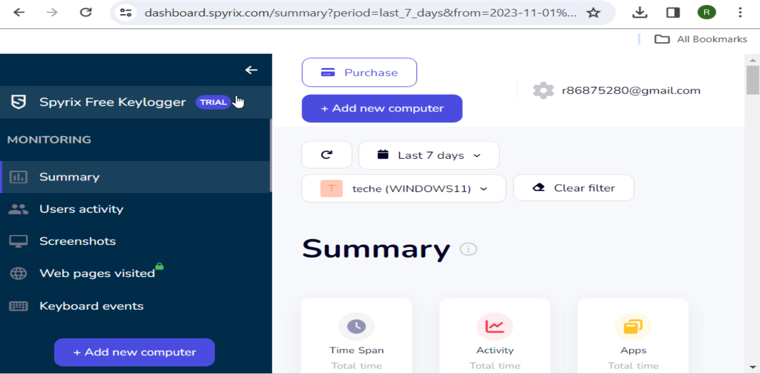
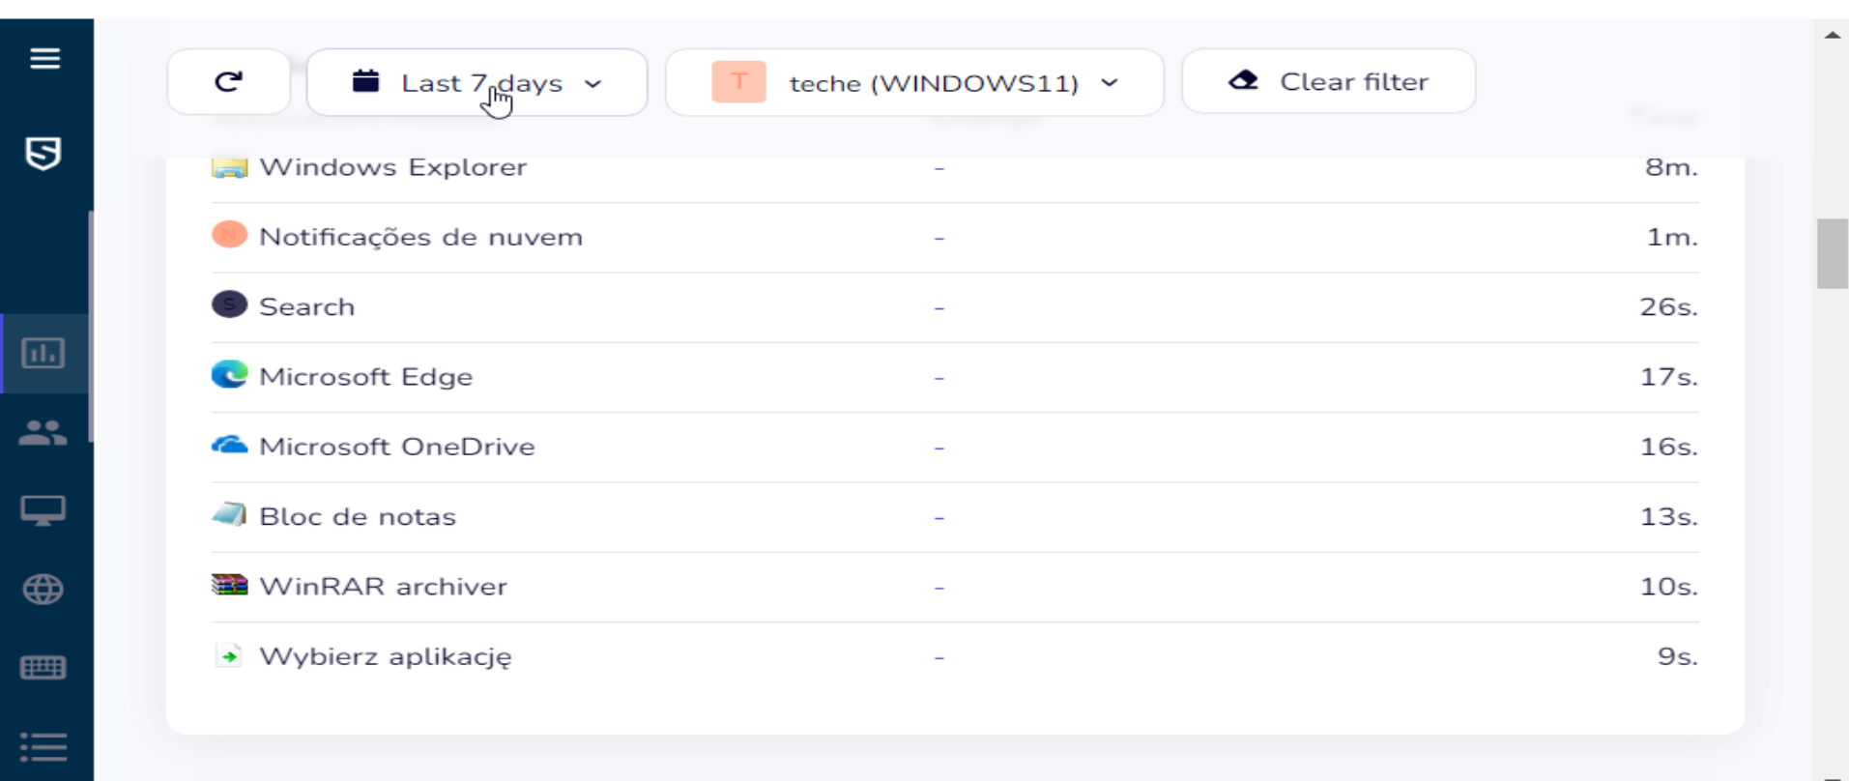
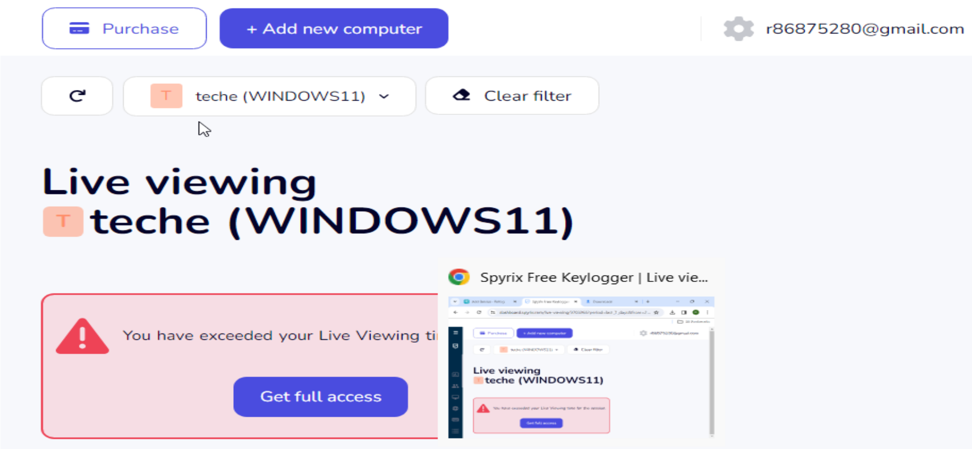
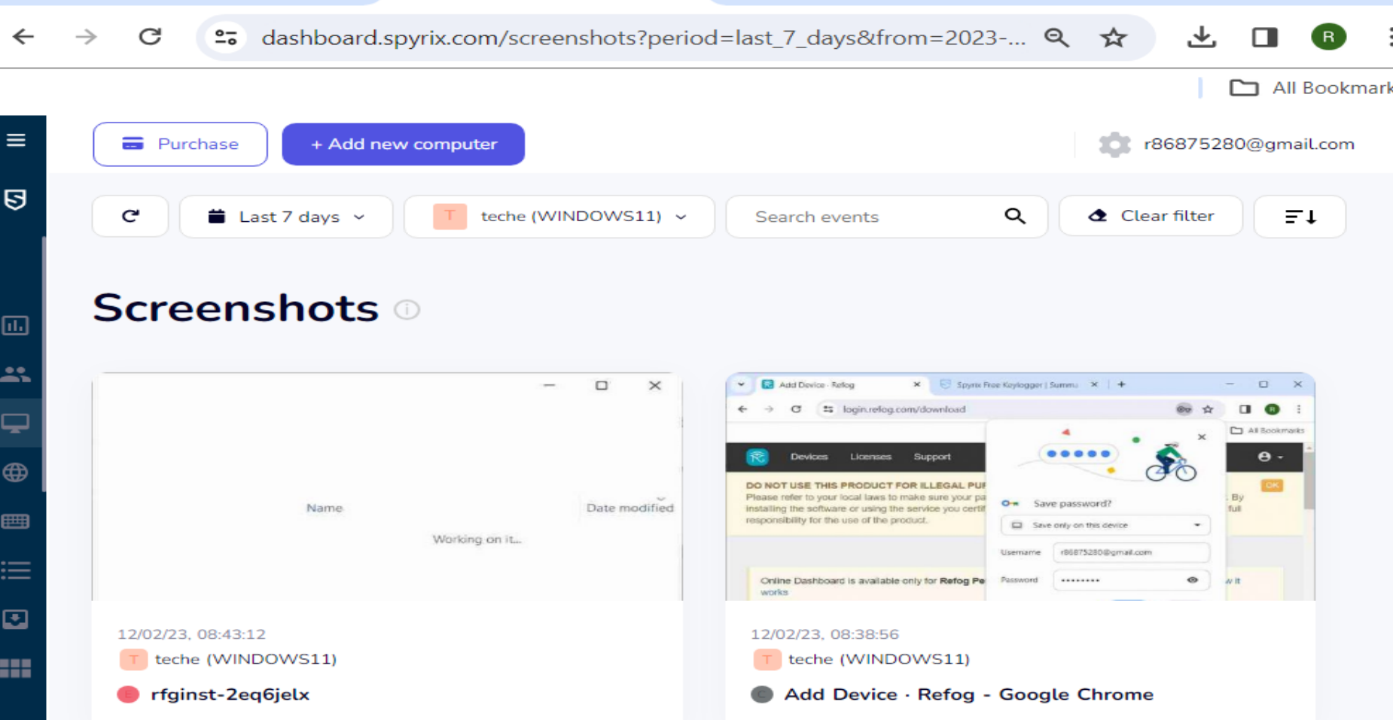
Keylogger Functionality Study(Contd.)
2. Example Keyloggers
- SPYRIX Keylogger: Features remote data access and uninstallation.

Slide 10
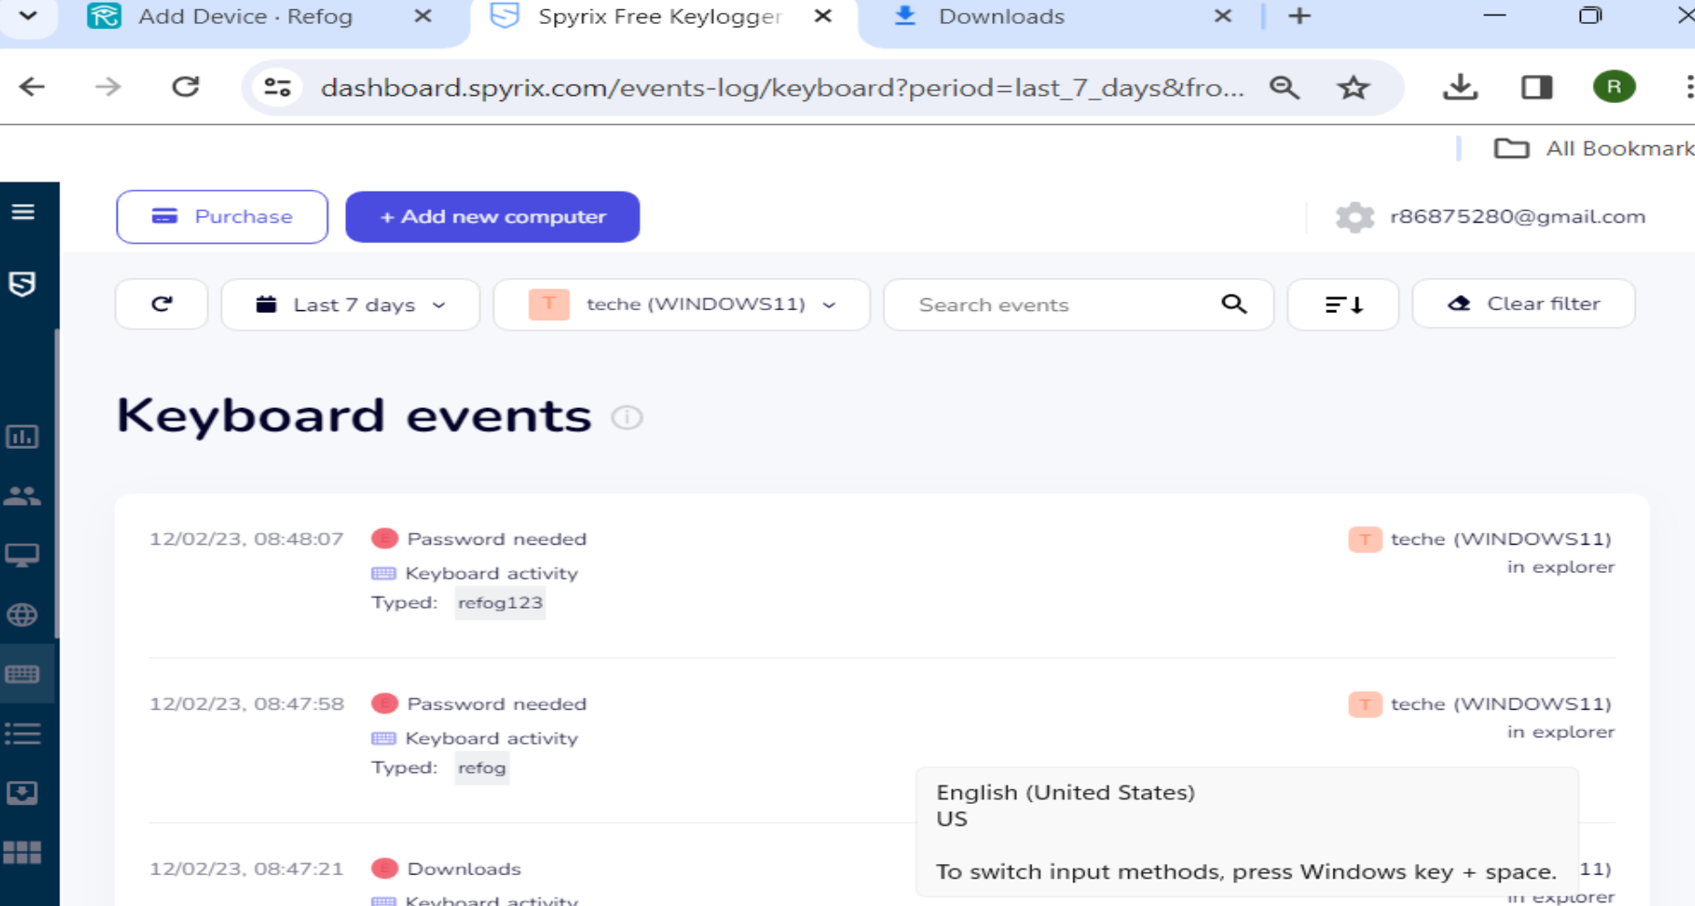
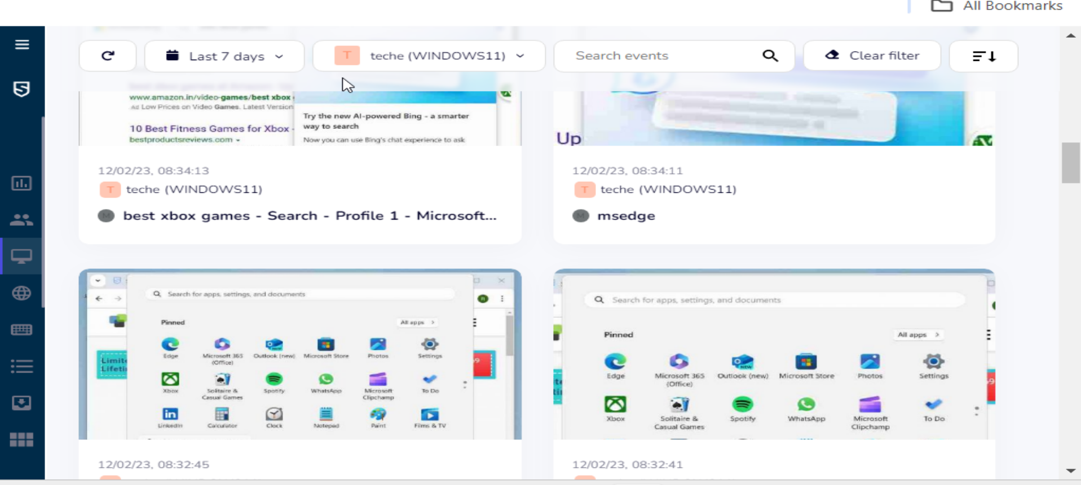
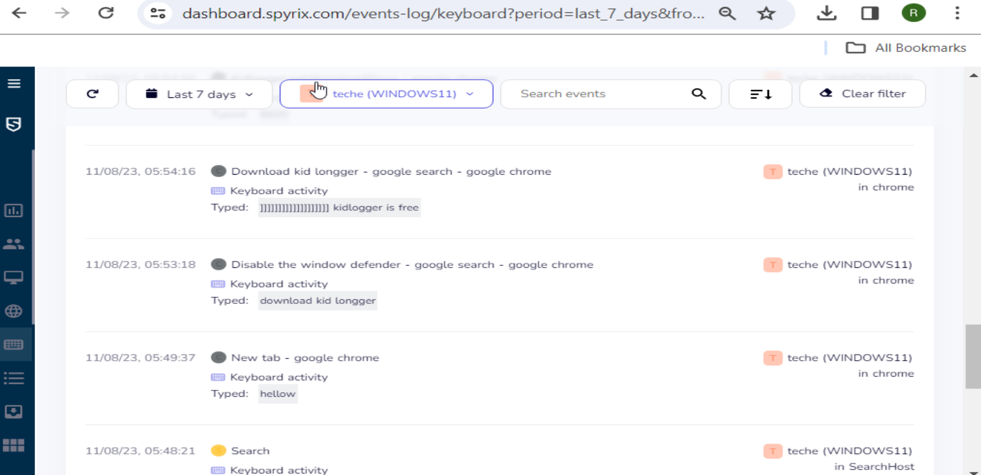
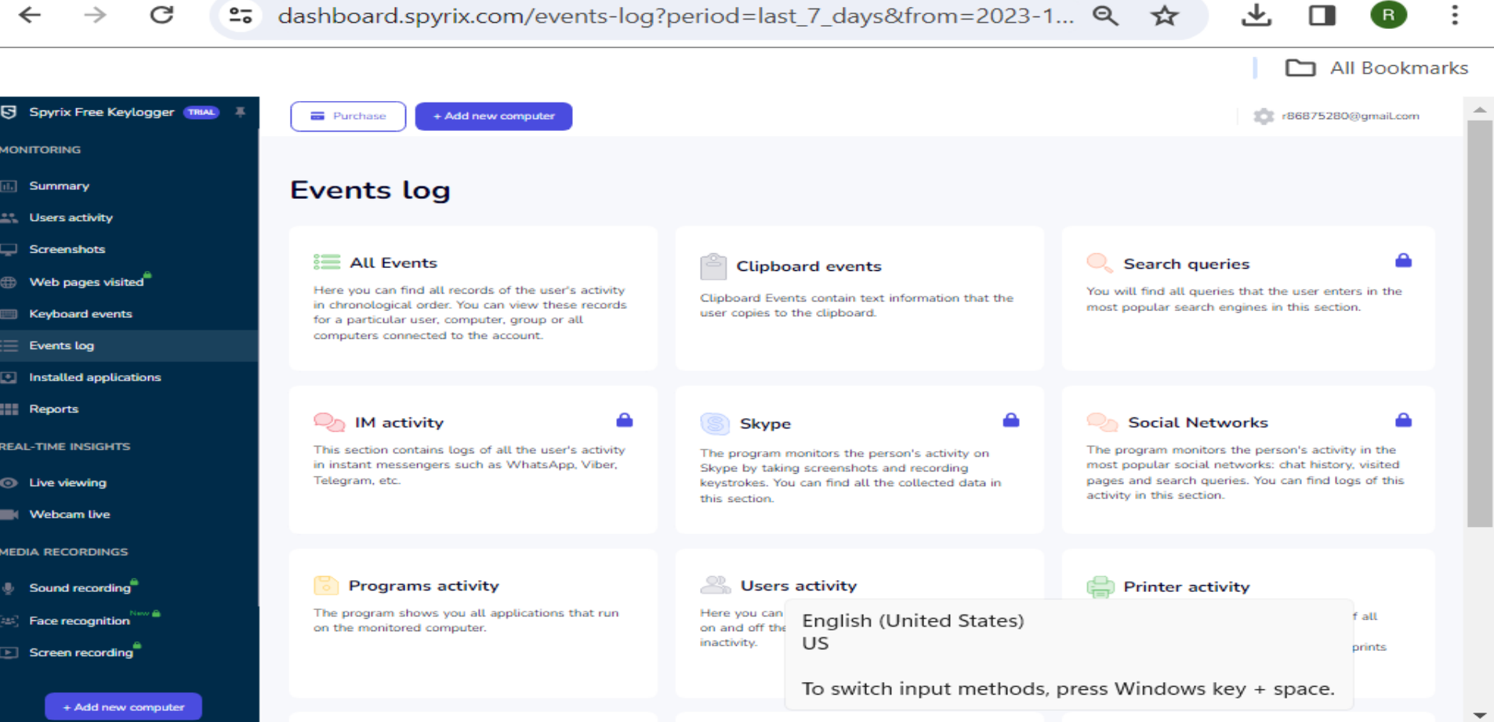
Keylogger Functionality Study(Contd.)

Slide 11
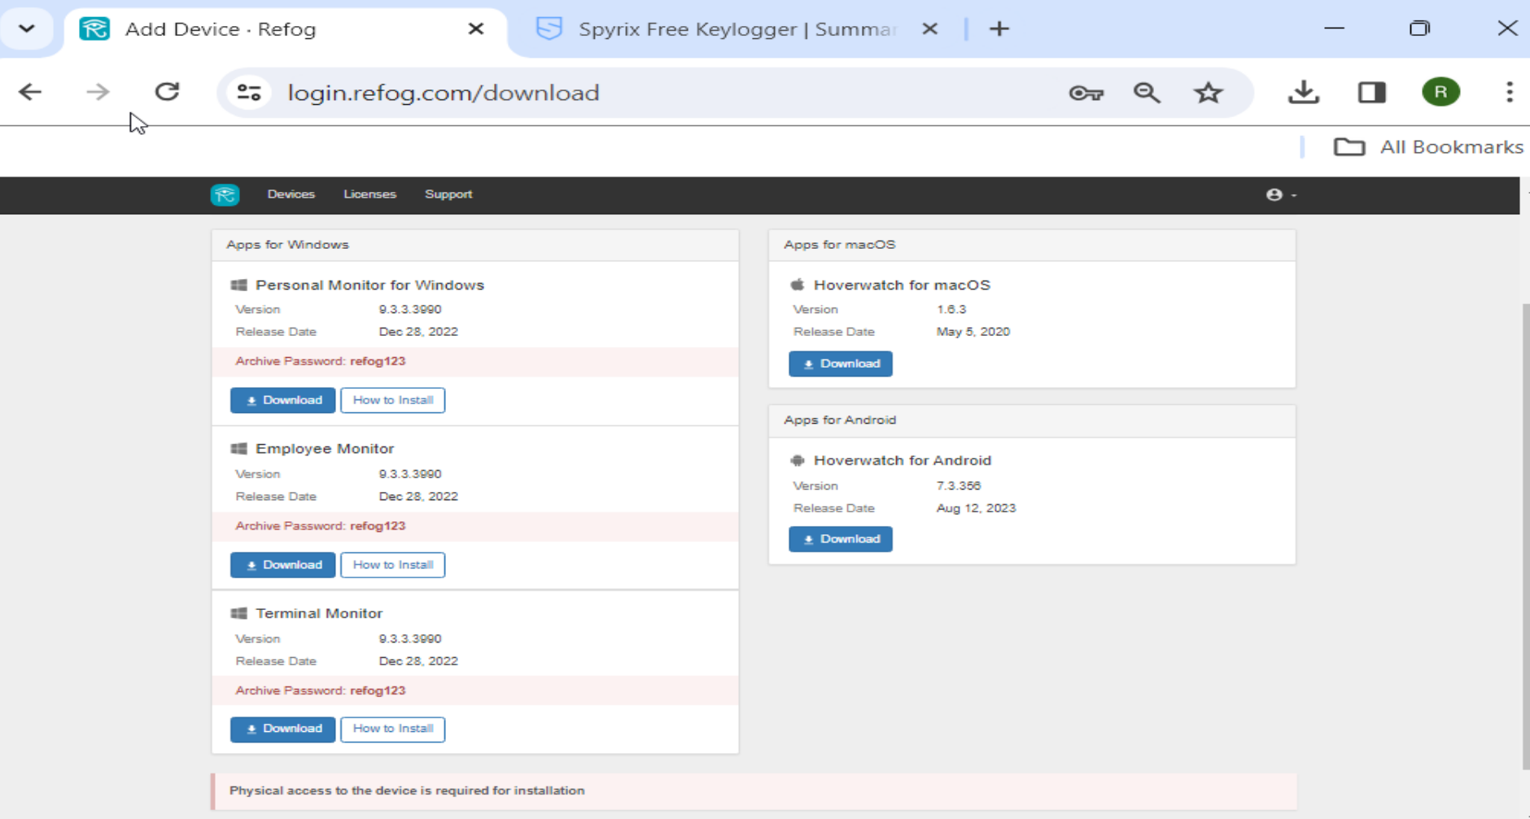
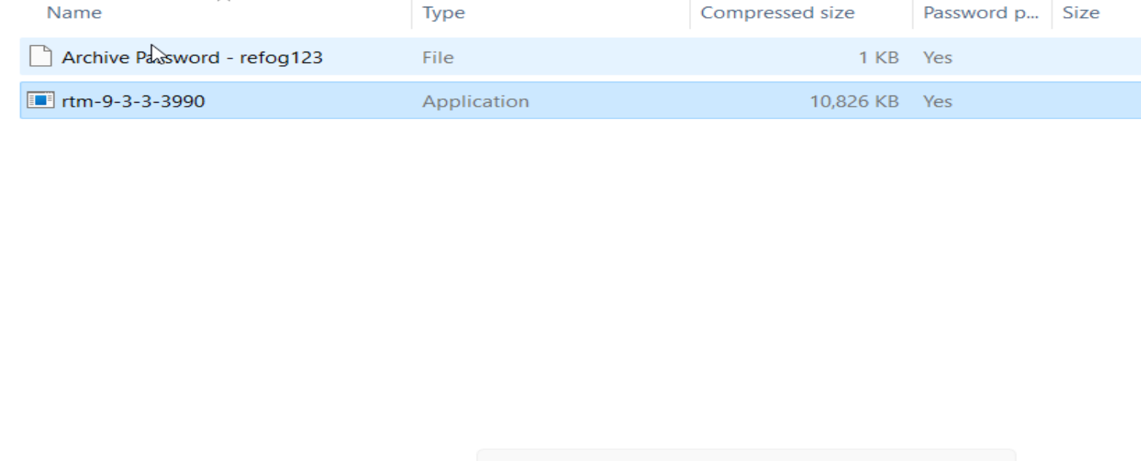
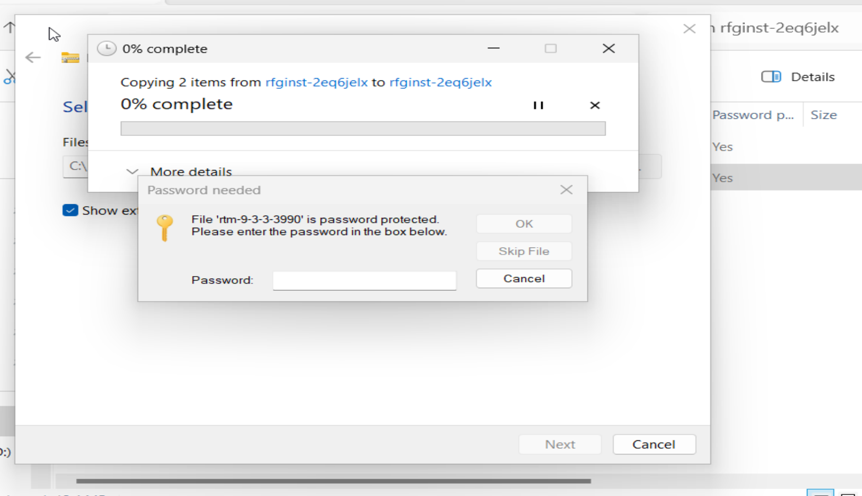
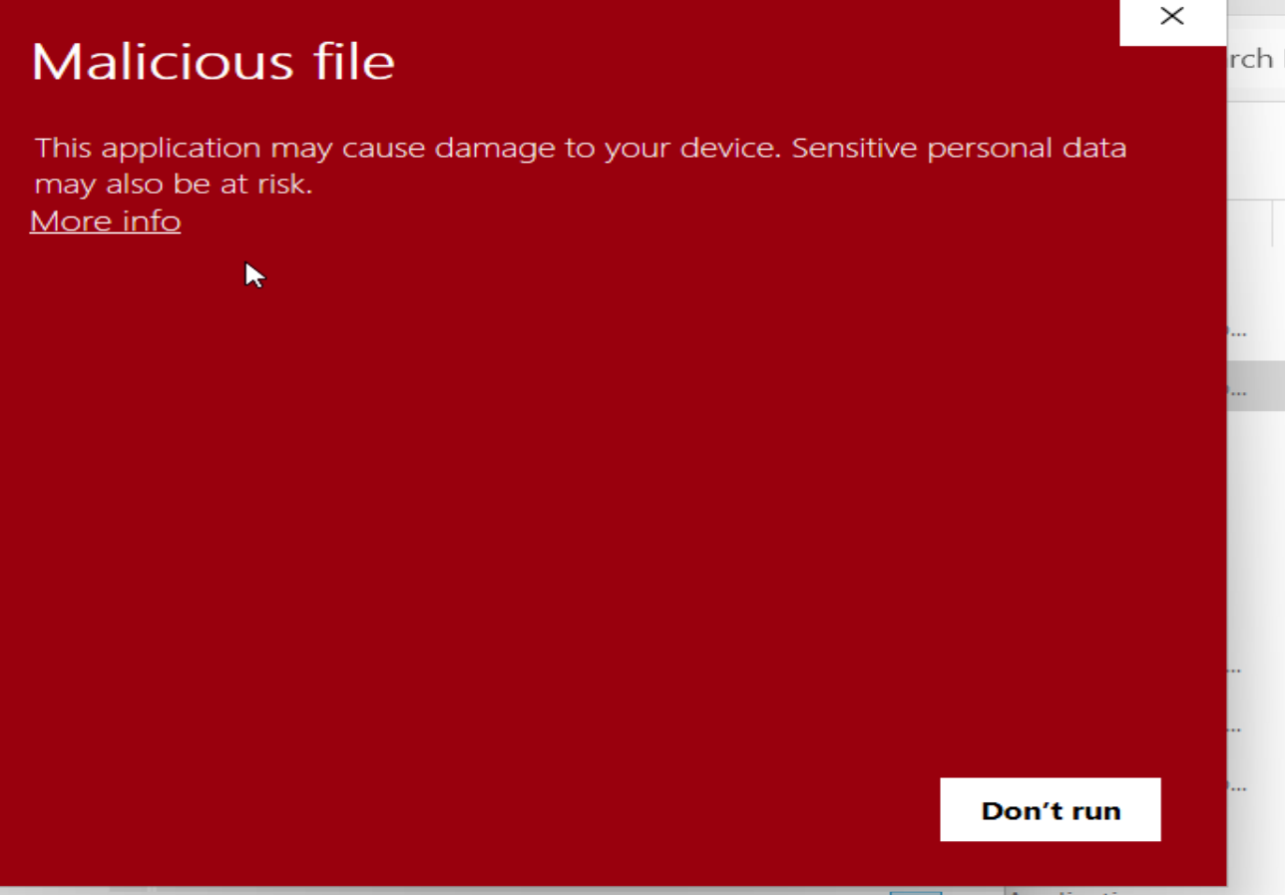
Keylogger Functionality Study(Contd.)
- REFOG Keylogger: Easy to use, comprehensive activity logging, and stealth operation.

Slide 12
Keylogger Functionality Study (Contd.)
3. Developing a Python Keylogger
- Utilized the `pynput` library for monitoring keyboard and mouse inputs.
- Created Python scripts for:
- Capturing single and multiple keystrokes.
- Handling special keys like 'space'.
4. Python Keylogger Script
- Script `keylogger.py` records keystrokes in 'keylog.txt'.
- Includes key press/release handling and file output functionality.

Slide 13
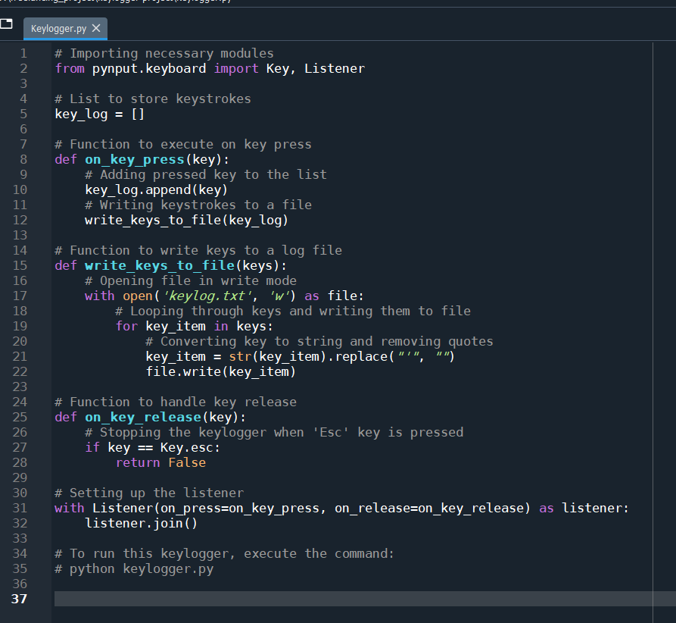
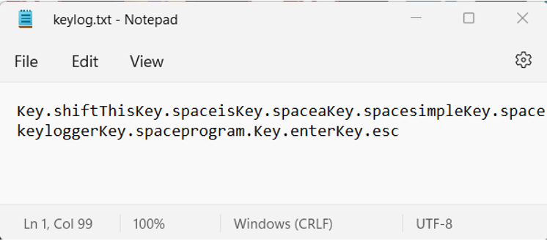
Keylogger Functionality Study (Contd.)

Slide 14
Detection and Countermeasure Assessment
1. Educational Preparedness
- Critical evaluation of email sources and content.
- Verification of website authenticity and security protocols.
- Continuous awareness programs on phishing and keylogging tactics.
2. Password Management
- Use distinct passwords for each account to minimize breach impact.
- Leverage password managers for complex, secure passwords.
- Regularly update passwords to prevent long-term access breaches.
3. Safeguarding Public Computer Use
- Avoid sensitive tasks on public computers.
- Change passwords and monitor accounts post-use.
4. Guarding Against Remote Keyloggers
- Regularly update software and operating systems.
- Be cautious with downloads and unsolicited updates.

Slide 15
Detection and Countermeasure Assessment (Contd.)
5. Detection Techniques
- Look for signs like slow browser, irregular input responses, or erratic cursor.
- Use system tools for monitoring and scan with antivirus software.
6. Keylogger Removal
- Utilize antivirus software for automatic detection and removal.
- Manually uninstall suspicious programs and clear temporary files.
7. Comprehensive Preventive Measures
- Implement network firewalls for additional security.
- Maintain strong, frequently updated passwords.
- Ensure timely system and application updates.
- Use antivirus software for broad-spectrum malware protection.

Slide 16
Analysis and Reporting
1. Data Organization
- Categorization based on keylogger types and detection methods.
- Separation of data into quantitative and qualitative sets.
2. Quantitative Analysis
- Statistical evaluation of detection rates and keylogger effectiveness.
- Comparative analysis of different keyloggers and security tools.
3. Qualitative Observations
- User experience aspects, like ease of use and stealthiness.
- Behavioral patterns and anomalies in system performance.
4. Synthesizing Insights
- Integrating quantitative and qualitative data for comprehensive understanding.
- Drawing conclusions on keylogger dynamics and defense strategies.

Slide 17
Results
1. Keylogger Functionalities
- Range from basic keystroke logging to advanced data capture and transmission.
- Increased sophistication in evading detection.
2. Vulnerabilities Identified
- System loopholes like unpatched software are key targets.
- User behavior, such as unsafe downloading practices, increases risk.
3. Detection and Countermeasures
- Mixed efficacy of antivirus programs; better results with behavior-based tools.
- Importance of user education and secure computing practices in prevention.
4. Overall Insights
- No single method fully effective against all keyloggers.
- Need for a multi-layered security approach combining technology and user awareness.

Slide 18
Conclusion
Final Reflections on Keylogger Analysis
In concluding our Keylogger Threat Analysis project, we've recognized the evolving complexity of keylogger technologies. Our study reveals that combating these threats requires more than just technological solutions; it necessitates a blend of robust cybersecurity tools and heightened user awareness. Keyloggers, with their advancing capabilities, underline the need for a multi-layered defense strategy that includes continuous updates in security practices and ongoing user education. This project not only enhances our understanding of keylogger intricacies but also advocates for a comprehensive approach to cybersecurity, combining technological vigilance with informed user behavior.

Slide 19
References
1. Anderson, R. (2020). Security Engineering: A Guide to Building Dependable Distributed Systems. Wiley.
2. Chen, L., & Zahid, S. (2019). "A Comprehensive Review of Keylogger and Screenlogger Attacks in Cybersecurity." Journal of Cybersecurity and Privacy, 2(3), 45-58.
3. Hoffman, L. (2018). "Detecting and Defending against Keyloggers." Cybersecurity Magazine, 5(2), 22-29
4. Kaspersky Lab. (2021). "Understanding Keyloggers."
5. NortonLifeLock Inc. (2022). "The Evolution of Malicious Keyloggers."
6. Patel, K. (2020). "The Role of User Behavior in Cybersecurity." Journal of Information Security, 11(4), 239-252
7. Symantec Corporation. (2021). "Symantec Internet Security Threat Report."
8. Williams, P., & Sawyer, S. (2019). Using Information Technology: A Practical Introduction to Computers & Communications. McGraw-Hill Education
9. Zhang, Y., & Monrose, F. (2018). "Behavioral Analysis of Keyloggers Using Machine Learning Techniques." Proceedings of the 5th International Conference on Security and Privacy in Communication Networks

